Slide 1
205 Feb 9, Class 16
Example publications
Writing with style
Preparing for the final project
Organizing into groups
Picking a topic

Slide 2
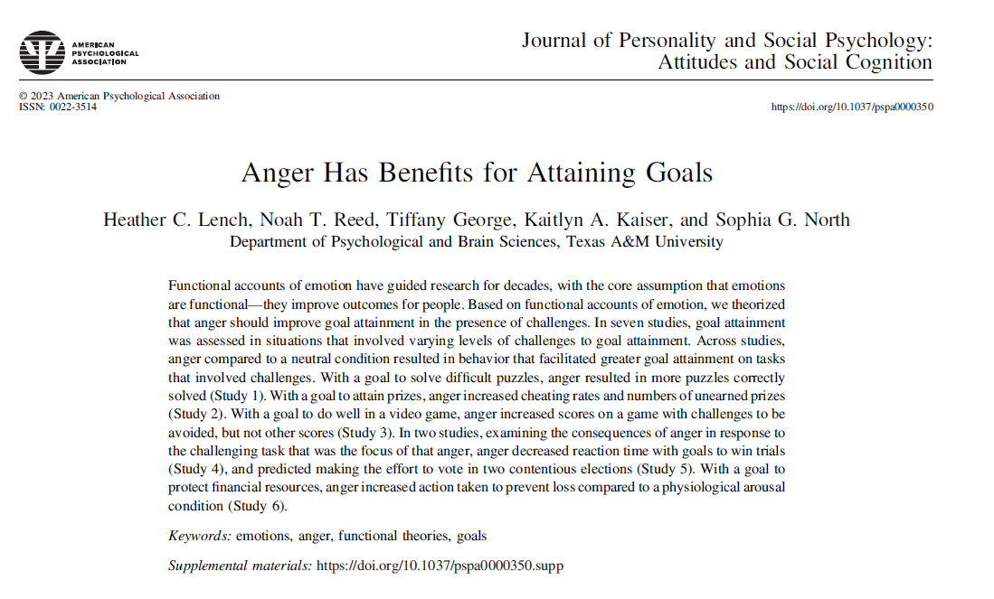

Slide 3
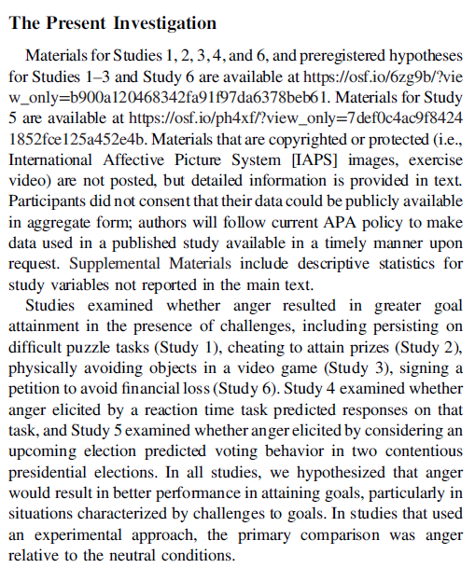
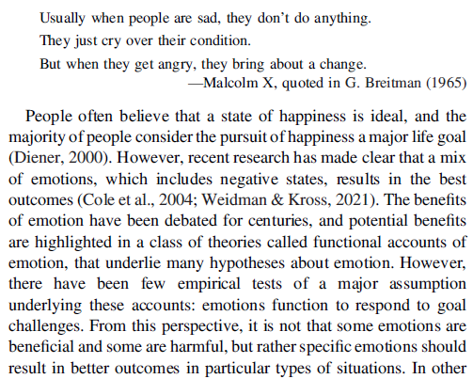
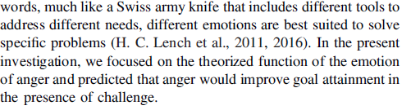

Slide 4
Introduction sentences
Find a sentence indicating the purpose of the study from the first 2 paragraphs of the Introduction.
Find sentences that indicate why this is an important research topic.
Sentences at the end of the Introduction that signal information about methodology.

Slide 5
Study 1
Study 1 was designed such that participants’ goal was to solve more puzzles. Anger was expected to increase goal attainment (i.e., number of puzzles solved) relative to a neutral state on challenging puzzles. The difficulty of the puzzles in this situation can be overcome with greater persistence in attempting to solve the puzzles, and therefore, we also examined persistence on the task. In addition to comparison to a neutral condition, the effects of anger were compared to the effects of other states that varied in their valence and approach orientation.

Slide 6
Methods
Participants were randomly assigned to emotion condition (anger, neutral, amusement, desire, sadness). Emotions were elicited through images that forwarded automatically in a slide show consisting of fifteen images displayed for 5 s each (a common emotion elicitation associated with medium-to-large effect sizes; H. C. Lench et al., 2011). Images from the IAPS (Lang, 1995) were chosen that have been shown to elicit amusement, sadness, anger, or neutral emotion in the previous standardization studies (Mikels et al., 2005).1 The number of IAPS images that elicit anger specifically is relatively small, and therefore, we developed seven images specific to the study population (e.g., insults to the university football team).

Slide 7
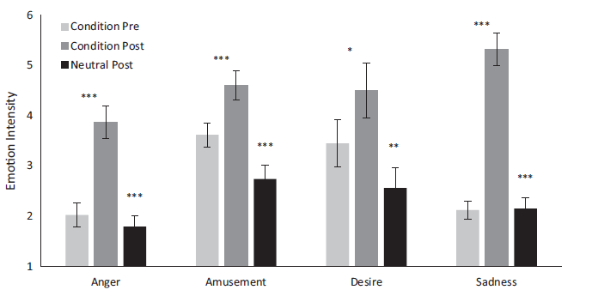
Manipulation check

Slide 8
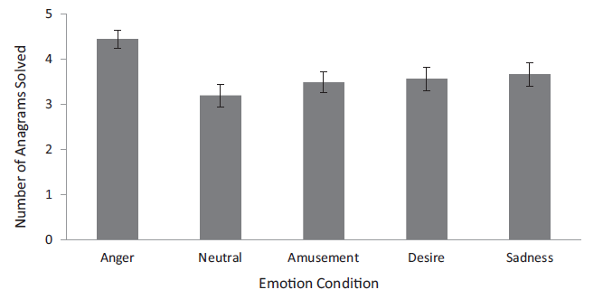
Anagrams solved
As shown in Figure 2, an analysis of variance (ANOVA) revealed that emotion condition affected the number of anagrams correctly solved on the difficult first set, F(4, 228) = 3.65, p = .007, η2 p = .06. The primary contrast of interest showed that participants in the anger condition solved more anagrams than those in the neutral condition, t(90) = 3.82, p < .001, d = .81. Compared to the neutral condition, this represents a 39.18% improvement in goal attainment (anagrams solved) when angry.

Slide 9
Additional studies
Study 2: anger led to more cheating (false self-report) on hard puzzle solutions
Study 3: video game play – skiing on Wii balance board
Hard/easy game
5 emotion levels
Anger led to better scores on only harder game
Study 4: decreased reaction times after unfair game
Study 5: non-experimental study comparing anger and voting tendency

Slide 10
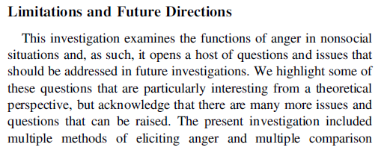
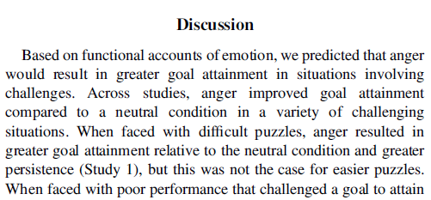
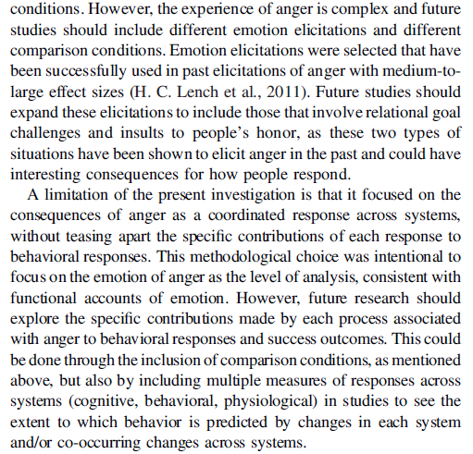
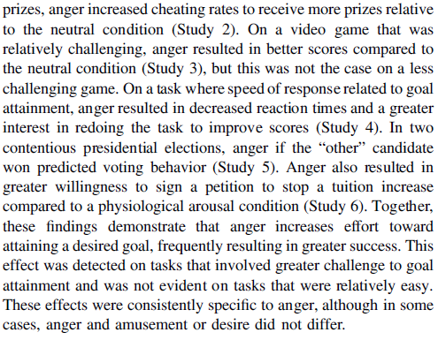

Slide 11
Discussion sentences
Comments that refer to theories referred to in the Introduction.
Statements of similarity or difference between this work and that of previous researchers or works by the same author.

Slide 12
Writing with Style
Reading published work focused on style
How they communicate instead of what
Using Google Scholar
Search by keywords
Find @ NU
Cite & Cited by links
Peer-reviewed journals
Avoid “Proceedings”

Slide 13
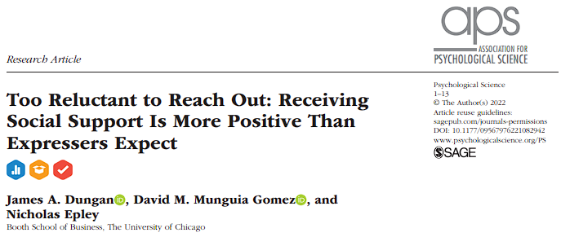
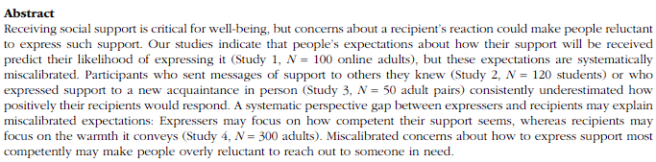

Slide 14
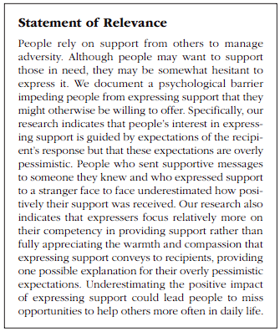
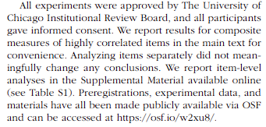

Slide 15
Understanding decisions to express support could therefore provide a critical theoretical contribution to the emerging literature on barriers to prosocial actions, as this understanding could provide evidence for a key boundary condition on an otherwise robust psychological tendency.
It could also be of meaningful practical value, given that decisions to express or withhold support likely happen when recipients are most in need and hence may be especially beneficial for recipients’ well-being.

Slide 16
Finally, Study 4 tested a prediction from our theory that a perspective gap is one mechanism for explaining why expressers underestimate the positive impact of their support. Specifically, we tested whether expressers tend to focus on how competently they can express support, whereas recipients focus relatively more on the warmth the support conveys

Slide 17
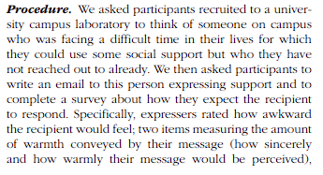
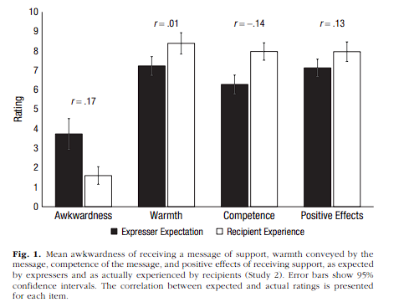

Slide 18
Discussion Sentences
Statements of similarity or difference between this work and that of previous researchers or works by the same author
Comments that refer to theories referred to in the Introduction

Slide 19
These results further suggest that people may think too narrowly about whom they can support. The relationship between expresser and recipient strongly influences expectations of how effective and appropriate support is (Lakey & Orehek, 2011; Rafaeli & Gleason, 2009; Veenstra et al., 2011), but Studies 2 and 3 suggest that these expectations may be misleading
These results are consistent with those of recent work demonstrating that rewarding social interactions are not confined to close others: Mere acquaintances are surprisingly effective at providing support (Small, 2017) and increasing well-being more generally (Epley & Schroeder, 2014; Sandstrom & Dunn, 2014a, 2014b).

Slide 20
Our studies suggest that even when people recognize that support is needed, they may be overly reluctant to express it because they hold miscalibrated expectations of their recipients’ response. Expectations of how their support would be received predicted expressers’ willingness to express it (Study 1), but these expectations were overly pessimistic with regard to both friends and strangers (Studies 2 and 3).

Slide 21
Preparing a Research Proposal
Organize into groups of 3-4 students
If you have trouble finding a group, email us
Meet and pick out your first main source paper
Use for operational definitions
Starting point for procedure
Prepare your initial proposal for Friday 11/4
Guidelines in Chapter 13

Slide 22
Initial Proposal Outline
Group members
Tentative project title
First background source (APA Reference Style)
Design of source experiment
IV(s), DV, number of participants, outcome
What new element are you planning to add?
Diagram your 2x2 design
2 factors, 2 levels each
Planned number of participants
 | Factor1-a | Factor1-b
Factor2-x
Factor2-y

Slide 23
Collaborative Research
Work together on design, data collection, analysis
Shared Methods & Results section
Work separately on Introduction, Discussion, Abstract
Make your own figures
Differing interpretations of the results are possible
Each paper is your own (first author)
Academic integrity
Building on other author’s ideas is not plagiarism, citations strengthen papers
Taking other people’s words as your own is plagiarism
Data fabrication is fraud

Slide 24
Practical points
Design must be 2x2
At least one factor must be manipulated across groups
Randomly assigned
Minimal ethical risk to participants
No personal/private information
No deception other than blind to conditions
No emotional manipulations
Online data collection can be used
Qualtrics: https://www.it.northwestern.edu/software/qualtrics/index.html

Slide 25
Planning for Final Proposal
Submit to us as if we are the IRB
Present a full description of your protocol
Motivating hypothesis
Procedure as a draft of your Methods section
All stimuli to be used
Working version of an online survey including all conditions
No data collection until explicit approval
Once approved, go as quickly as possible

Slide 26
For Mon 2/12
Final projects initial ideas
Chapter 14: Non-experimental designs

